Slide 1
Revelation
The Incomparable Christ
Christology: The Person & Work of Jesus
The Writing Ministry of Jesus
Dr. Rick Griffith • Jordan Evangelical Theological Seminary • BibleStudyDownloads.org
Notes:
Slide 173

Slide 2
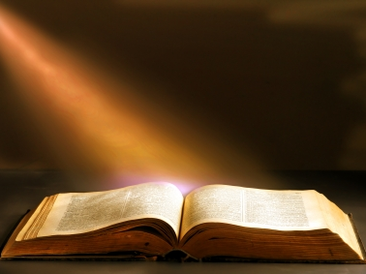
Revelation 1

Slide 3
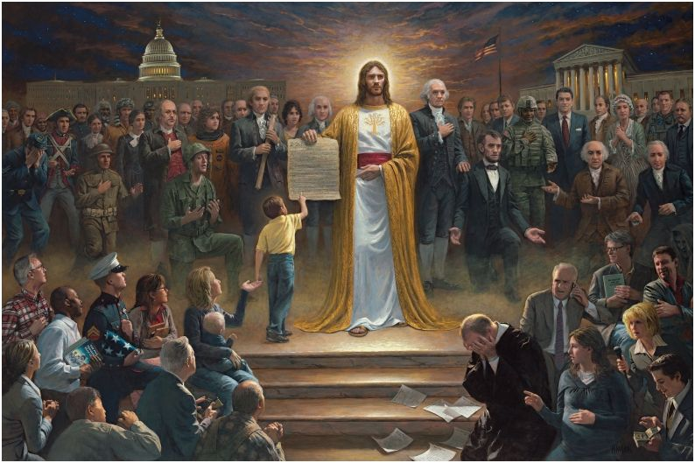
One Nation Under God
By Jon McNaughton (2012)
http://jonmcnaughton.com/content/ZoomDetailPages/OneNationUnderGod.html
Notes:
http://jonmcnaughton.com/content/ZoomDetailPages/OneNationUnderGod.html
Interview with the Artist: http://jonmcnaughton.com/content/ZoomDetailPages/OneNationInterview.html

Slide 4
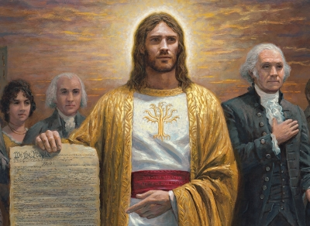
Jesus Christ, the Most Controversial Person
http://jonmcnaughton.com/content/ZoomDetailPages/OneNationUnderGod.html
Notes:
http://jonmcnaughton.com/content/ZoomDetailPages/OneNationUnderGod.html
Interview with the Artist: http://jonmcnaughton.com/content/ZoomDetailPages/OneNationInterview.html

Slide 5
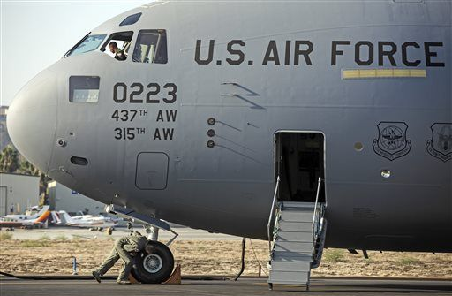
"God" Now Optional in US Air Force Oath
The full oath: "We will not lie, steal or cheat nor tolerate among us anyone who does. Furthermore, I resolve to do my duty and live honorably, so help me God."
Notes:
(Newser 25 Oct 2013) – An oath of honor uttered by Air Force cadets might be a little less godly from here on out. The service says cadets now have the option to skip the last phrase, "So help me God," reports the Air Force Times. The move comes in response to a group pushing for separation of church and state in the military, but it might not be enough to ward off a lawsuit. The Military Religious Freedom Foundation wanted the phrase cut entirely—the Air Force chose to keep it, but make it optional.
The full oath: "We will not lie, steal or cheat nor tolerate among us anyone who does. Furthermore, I resolve to do my duty and live honorably, so help me God." The founder of the MRFF calls it unconstitutional, though he wouldn't object if cadets continued to say the phrase even if it were stripped from the official oath. "They can swear so help me God, so help me Allah, so help me Spider-Man. But when you have it there, that is a noxious violation of separation of church and state."

Slide 6
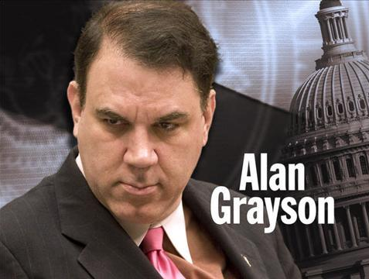
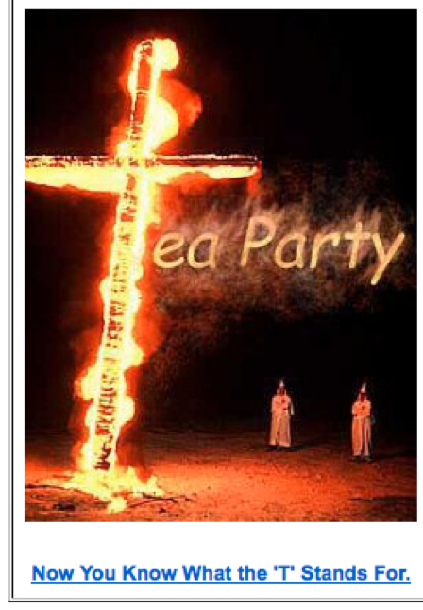
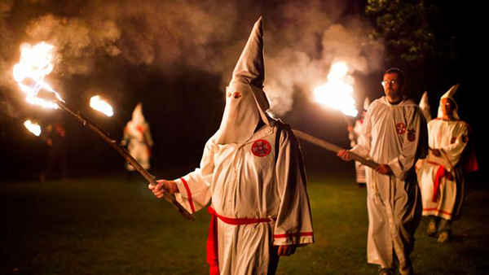
Sinking to new lows…

Slide 7
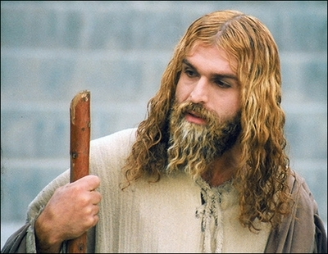
A Muslim actor as Jesus Christ in Iran (29 April 2008)
Who am I?
Notes:
http://latimesblogs.latimes.com/babylonbeyond/2008/04/iran-an-iranian.html
IRAN: A Muslim actor as Jesus Christ
Comments (19)
(13)
(0)
April 29, 2008 | 3:00 am
He is an Iranian Muslim who looks so much like a Hollywood or Renaissance image of Jesus Christ that the faithful sometimes make the sign of the cross when they see him.
Ahmad Soleimani-Nia has been playing Jesus for seven years, keeping his hair long and lightly dyed, his beard knotty and vibrant.
He is the star of "Jesus, the Spirit of God," a new film from Iran that depicts the man Christians believe to be the messiah and son of God as a tormented Judean prophet heralding the coming of Muhammad, the founder of the Muslim faith. Nia's Jesus is at once serene, devout, driven and passionate.
In real life, if there is a real life after a spiritual and artistic odyssey that is still not over, Nia lives in Tehran. He was once a soldier in the Iranian army and then a welder for — the irony is interesting in this Jesus story — his nation's Atomic Energy Agency, which the Bush administration accuses of pursuing nuclear weapons.
That may unsettle some American neo-cons, but perhaps not as much as the film itself, which suggests that Jesus wasn't crucified and never rose from the dead.
Check out the rest of the story in today's Los Angeles Times.
— Jeffrey Fleishman in Tehran
Photo: Ahmad Soleimani-Nia as Jesus. Credit: minbar.tatar.ru/rus/Messiah.htm

Slide 8
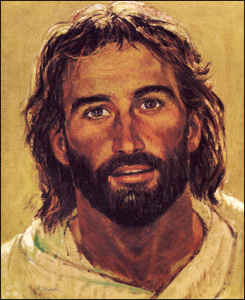
Jesus was relevant in the 1980s

Slide 9
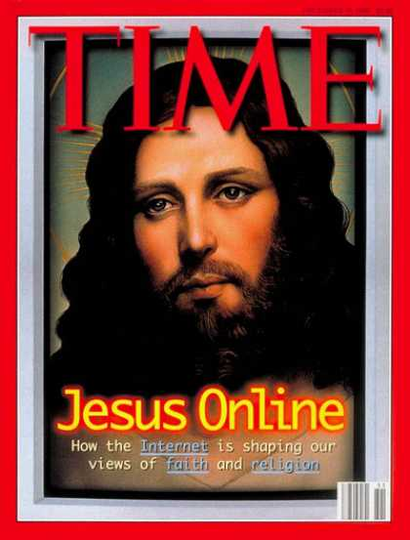
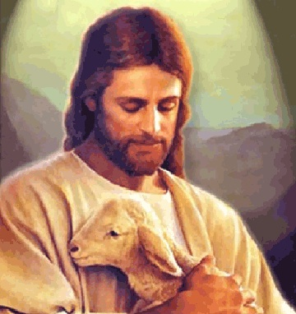
But Jesus became wimpy

Slide 10
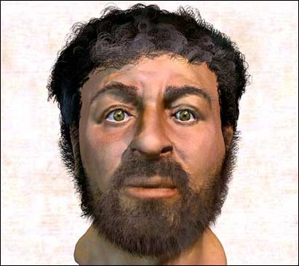
So Jesus became a caveman
Then sculptors gave it a try
Notes:
This depiction of Christ was determined by collecting samples of first-century Jewish facial bone structures to provide a composite "average" man for that time.

Slide 11
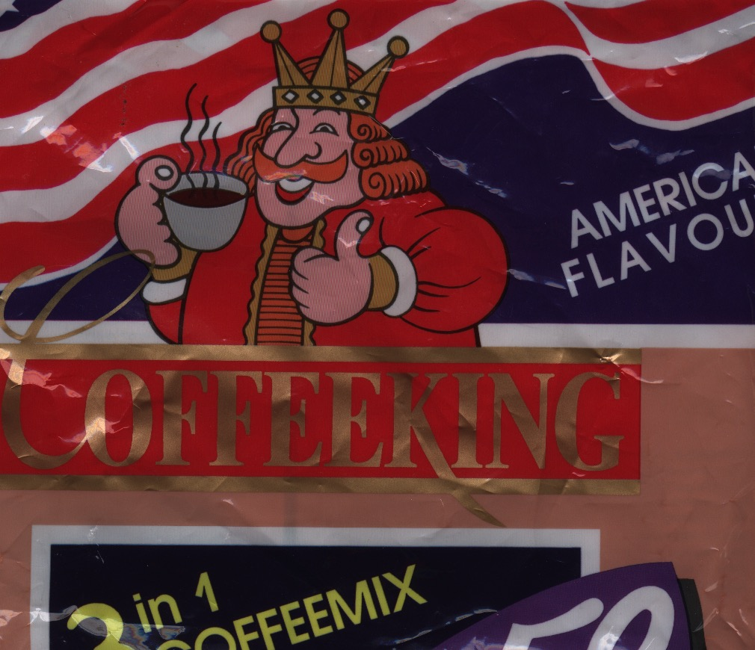
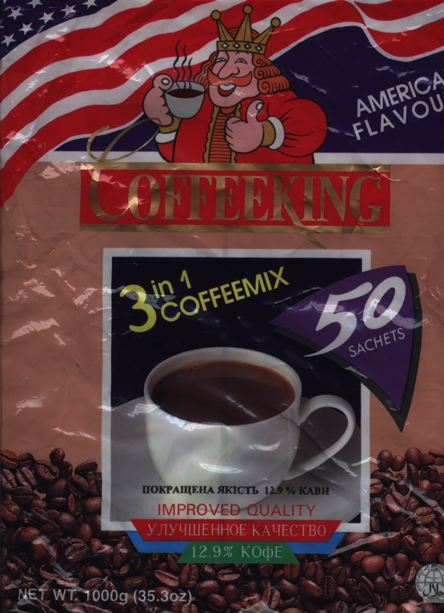
Who is the Real King?
The Triumph of Christ
Notes:
My favourite instant coffee is the "American Flavour" Coffee King brand. Interestingly, each packet shows a king drinking coffee. Since America was established in rebellion to the King of England and the USA has never had a king, one wonders who this king is on the package! Nevertheless, it does raise the issue of who really rules the world. The book of Revelation is quite clear on this question as it removes all doubt in showing that Christ is the Ultimate Victor and Sovereign over all creation.

Slide 12
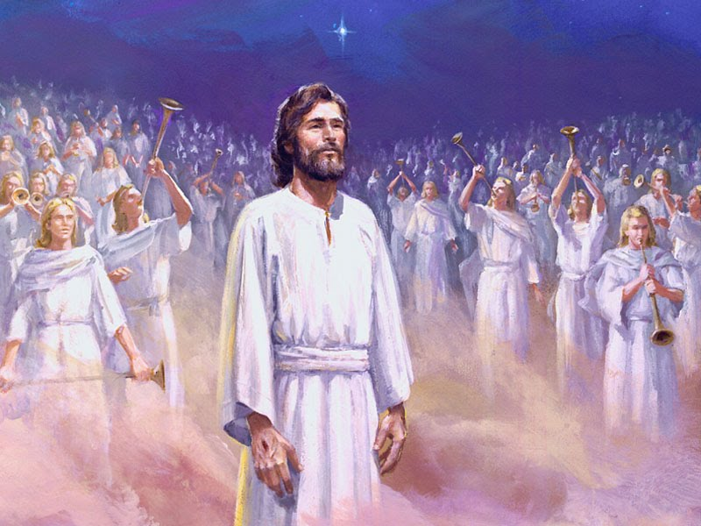
Why should we know that Jesus rules the world?
318
The Triumph of Christ

Slide 13
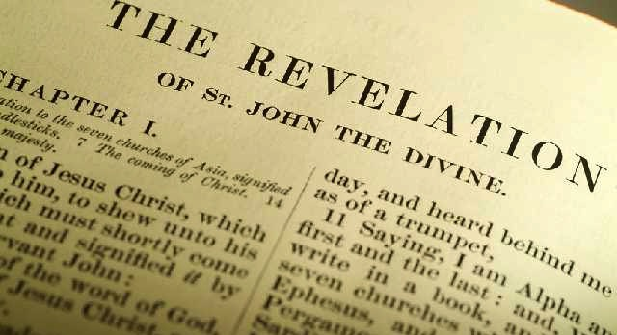
What's the Title?
319
The Book of Revelations?
The Book of Revelation

Slide 14
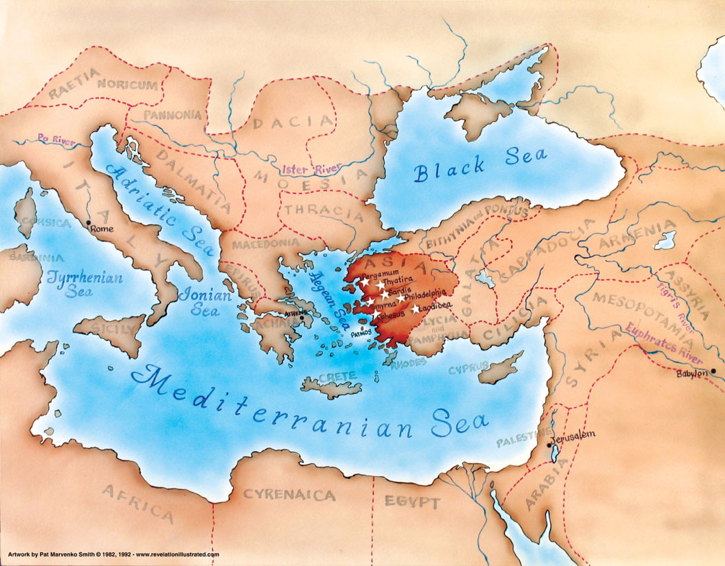
Asia in the Roman Empire
321

Slide 15
What did John see around him?
Title Page 321
Asian Churches
Rome
2. External Persecution from Rome (1:9; 2:9-10; 3:10)
1. Internal Struggles inside churches (2:4, 14-15, 21-24; 3:1, 15-17)

Slide 16
Why should we know that Jesus rules the world?
318
Why read Revelation?
Why worship Jesus?
Why see Jesus clearly?

Slide 17
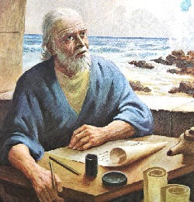
I. Reading and obeying this Revelation of Christ's sovereignty brings blessing (1:1-3).
343

Slide 18
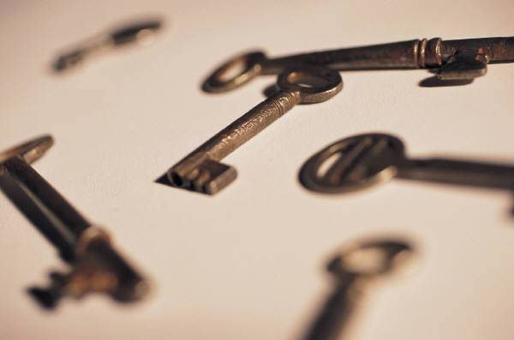
Christ's sovereignty over future events transmitted to John shows the prophecy as inspired (1:1-2)
322
Points H & I
God
"The revelation of Jesus Christ, which God gave him to show to his servants the things that must soon take place. He made it known by sending his angel to his servant John, who testifies to everything he saw––that is, the word of God and the testimony of Jesus Christ" (1:1-2 NIV).
Jesus
Angel
John
Readers (servants)
Notes:
"How did the Lord convey the contents of this book to His servant? According to Revelation 1:1–2, the Father gave the revelation to the Son, and the Son shared it with the apostle, using "His angel" as intermediary. Sometimes Christ Himself conveyed information to John (Rev. 1:10ff); sometimes it was an elder (Rev. 7:13); and often it was an angel (Rev. 17:1; 19:9–10). Sometimes a "voice from heaven" told John what to say and do (Rev. 10:4). The book came from God to John, no matter what the various means of communication were; and it was all inspired by the Spirit" (Wiersbe, Be Ready, Bible Exposition Commentary).

Slide 19
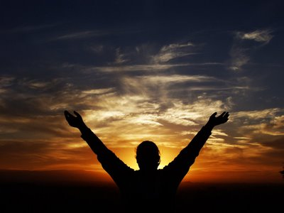
Characteristics
322
This is the only book in the Bible that promises a special blessing for reading it (1:3).
"God blesses the one who reads the words of this prophecy to the church, and he blesses all who listen to its message and obey what it says, for the time is near" (1:3 NLT)

Slide 20
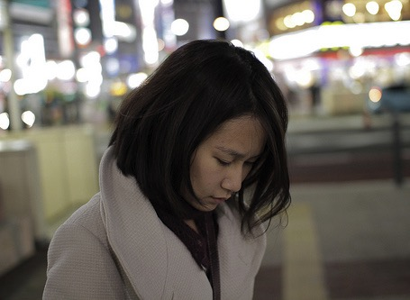
We often look down…

Slide 21
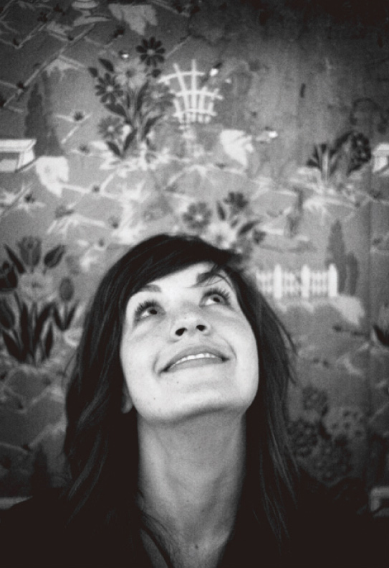
…so why should you look up and why worship Jesus during your struggle?

Slide 22
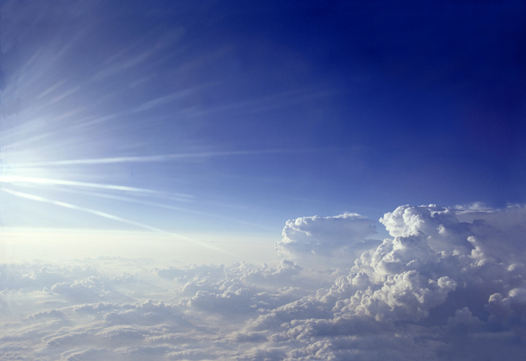
II. We should worship the triune God because Christ will soon return (1:4-8).

Slide 23
"Grace and peace to you from the one who is, who always was, and who is still to come"
Father
Rev. 1:4-6
is
is not
is not
GOD
is
is
Son
Spirit
"and from Jesus Christ…"
"…from the sevenfold Spirit before his throne"
is not
H. Wayne House, Charts of Christian Theology and Doctrine, 45

Slide 24
Redemption in Christ (1:5b-6)
"He is the faithful witness to these things, the first to rise from the dead, and the ruler of all the kings of the world. All glory to him who loves us and has freed us from our sins by shedding his blood for us. ⁶He has made us a Kingdom of priests for God his Father. All glory and power to him forever and ever! Amen."

Slide 25
"Look! He comes with the clouds of heaven. And everyone will see him— even those who pierced him. And all the nations of the world will mourn for him. Yes! Amen!"
Rev. 1:7 NLT
cf. Zech. 12:10

Slide 26
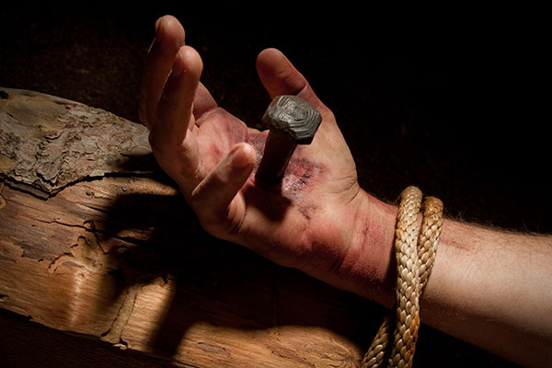
The Repentance of Israel
""Then I will pour out a spirit of grace and prayer on the family of David and on the people of Jerusalem. They will look on me whom they have pierced and mourn for him as for an only son. They will grieve bitterly for him as for a firstborn son who has died." (Zech. 12:10 NLT).

Slide 27
"Look! He comes with the clouds of heaven. And everyone will see him— even those who pierced him. And all the nations of the world will mourn for him. Yes! Amen!"
Rev. 1:7 NLT
cf. Zech. 12:10

Slide 28
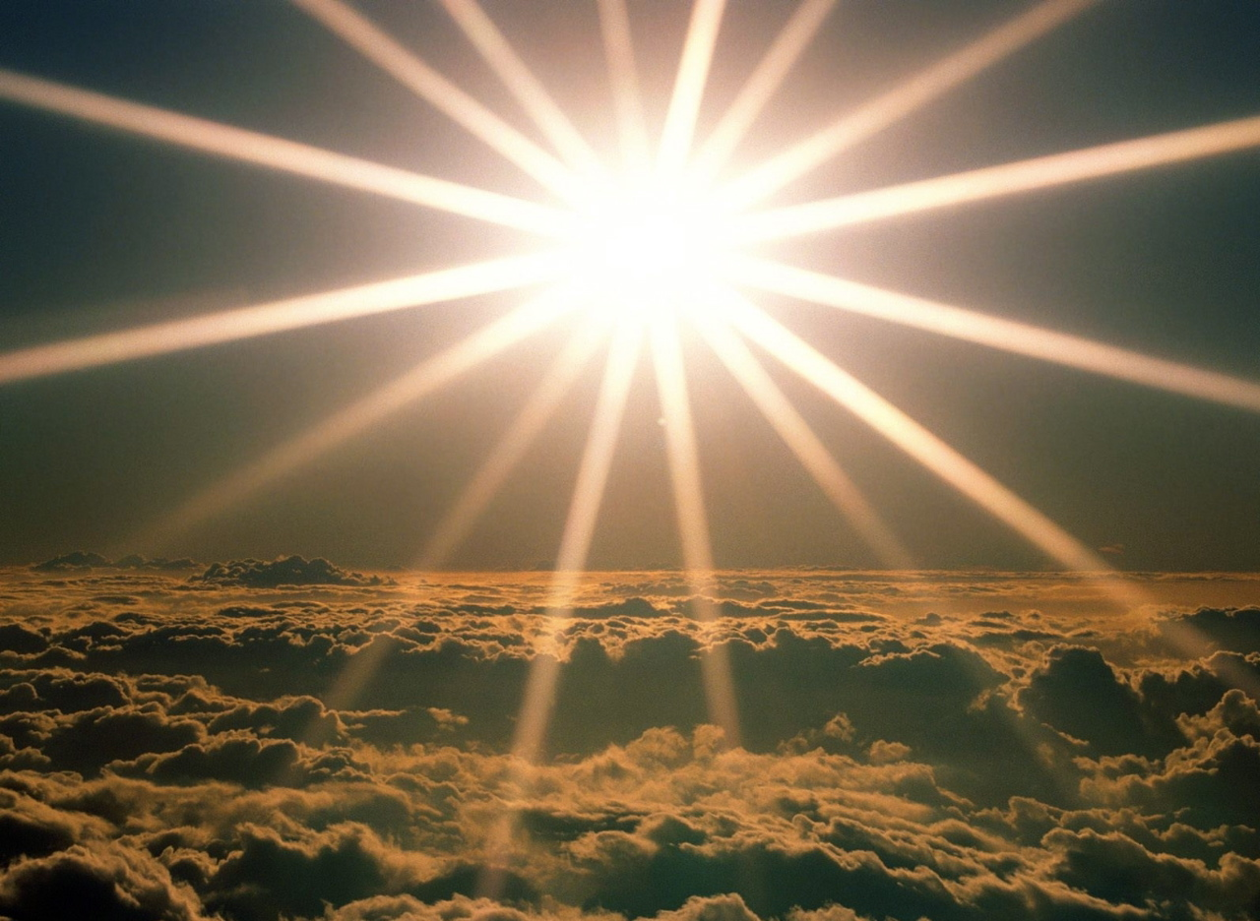
"I am the Alpha and the Omega—the beginning and the end," says the Lord God. "I am the one who is, who always was, and who is still to come—the Almighty One" (1:8 NLT).
iii

Slide 29
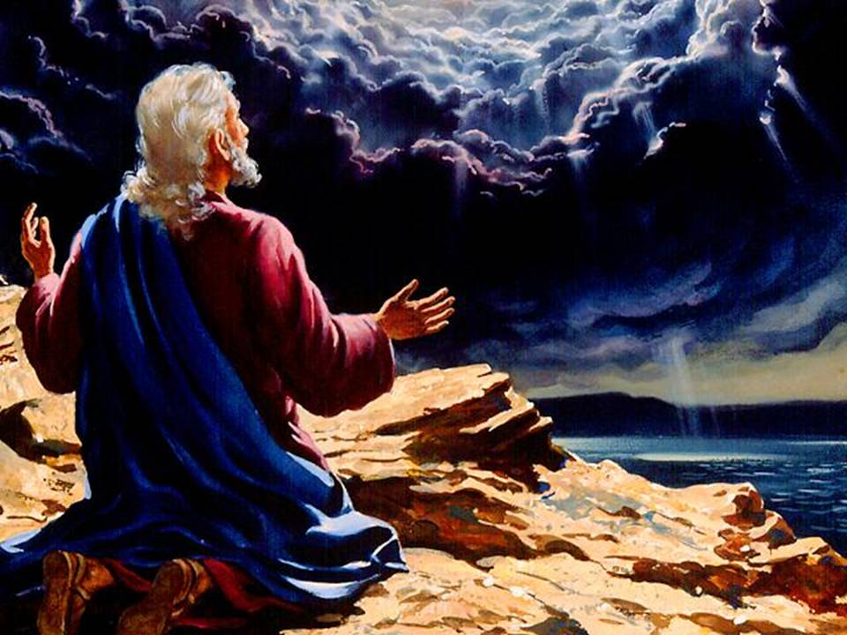
Why see Jesus clearly?
343
Notes:
"Tradition says that it was Domitian who sent John to the Isle of Patmos, a Roman penal colony off the coast of Asia Minor. This being the location of John's exile, perhaps it is not surprising that the word sea is found twenty-six times in his book" (Warren Wiersbe, Bible Exposition Commentary)

Slide 30
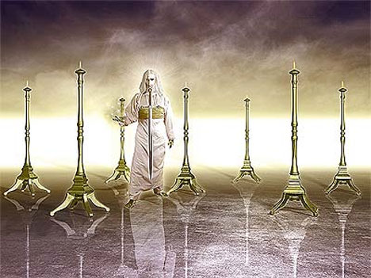
III. Seeing Christ glorified shows He can solve your problems (1:9-20).
343

Slide 31
The Twofold Context of the Book
Internal Compromise
321
External Persecution
Patmos
"I, John, am your brother and your partner in suffering and in God's Kingdom and in the patient endurance to which Jesus calls us. I was exiled to the island of Patmos for preaching the word of God and for my testimony about Jesus" (Rev. 1:9 NLT)
Notes:
Two factors will help us understand the historical situation in AD 95 with these churches scattered throughout the Empire:
External persecution against the churches is noted in 1:9 [click] that began in Rome and spread by imperial edict
Internal compromise within most churches is rebuked in chapters 2-3: division, false teaching, sinful living, self-centered luxurious lifestyles, etc.
What evidence of internal compromise and eternal persecution do you see in your own experience today? How can you relate?

Slide 32
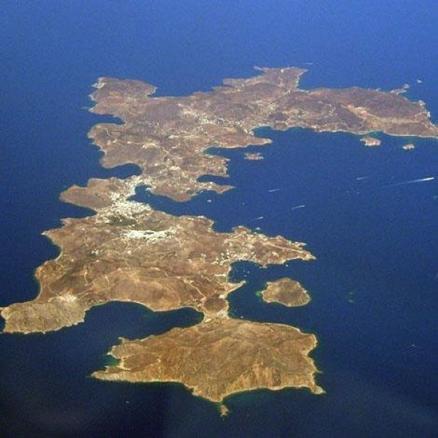
The Island of Patmos
Notes:
"The small island of Patmos is about 7.5 miles (12 km) long from north to south and at its widest is 6 miles (10 km) from east to west. It is the northernmost island of the Dodecanese. With an area of 13 square miles (35 sq. km) and a circumference of 25 miles (37 km), the volcanic island presents a largely rocky and treeless landscape" (http://www.bibleplaces.com/patmos.htm).

Slide 33
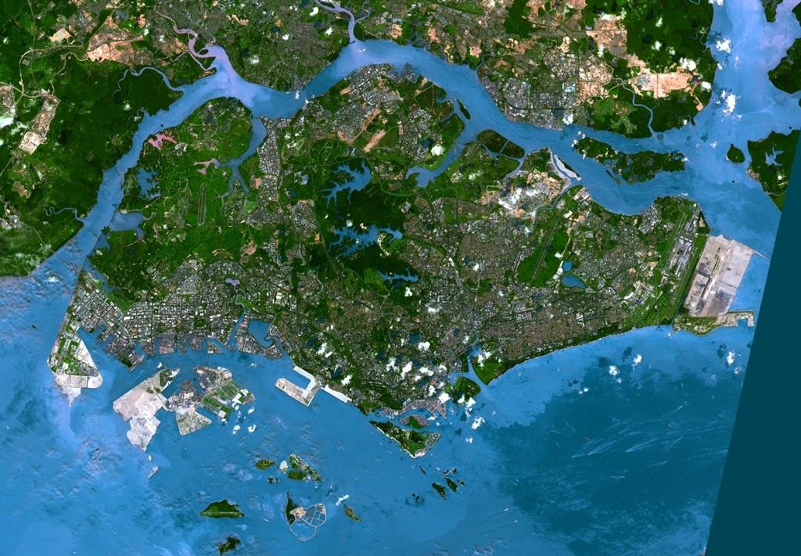
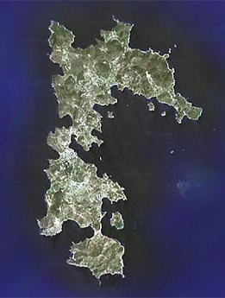
Satellite Comparison of Singapore with Patmos
Patmos

Slide 34
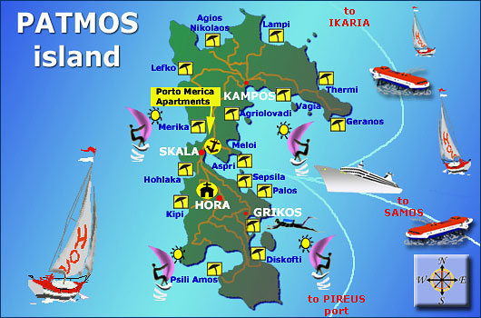
The Tourist Island of Patmos

Slide 35
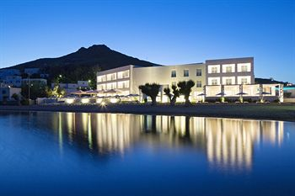
Luxury Hotels on Patmos

Slide 36
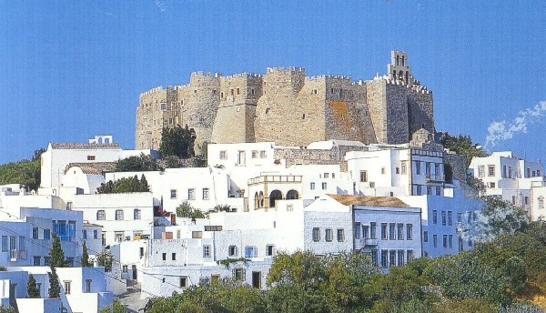
Monastery of St. John at Patmos
Notes:
"The most imposing building on the island is the Monastery of St. John the Theologian. Constructed by Christodoulos in 1088, the monastery is located in the town of Chora overlooking the harbor. With walls 50 feet (15 m) high, it was built like a fortress because of the threat from pirates. The monastery was built on top of the remains of a 4th century AD church and an earlier temple of Artemis. An inscription that mentions the temple of Artemis is displayed in the monastery's museum" (http://www.bibleplaces.com/patmos.htm).

Slide 37
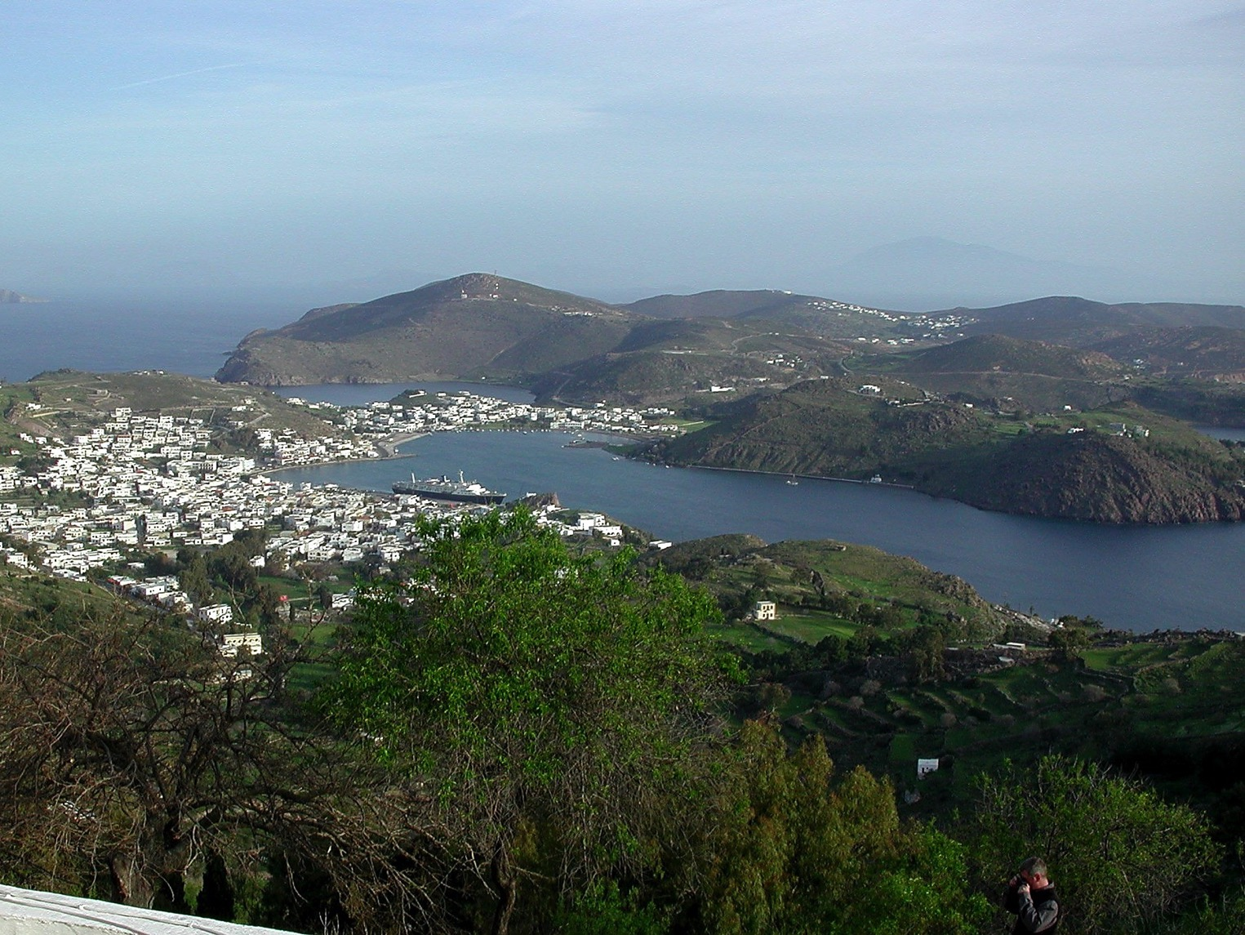
John's View from the Top

Slide 38
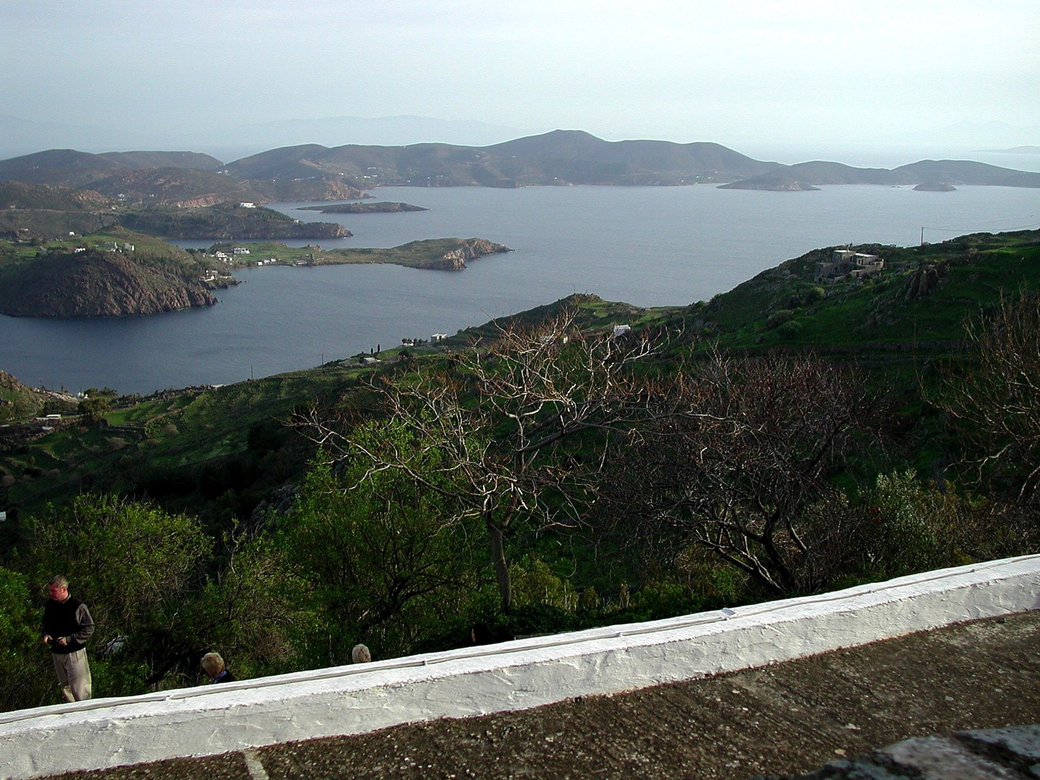
John's View from the Top

Slide 39
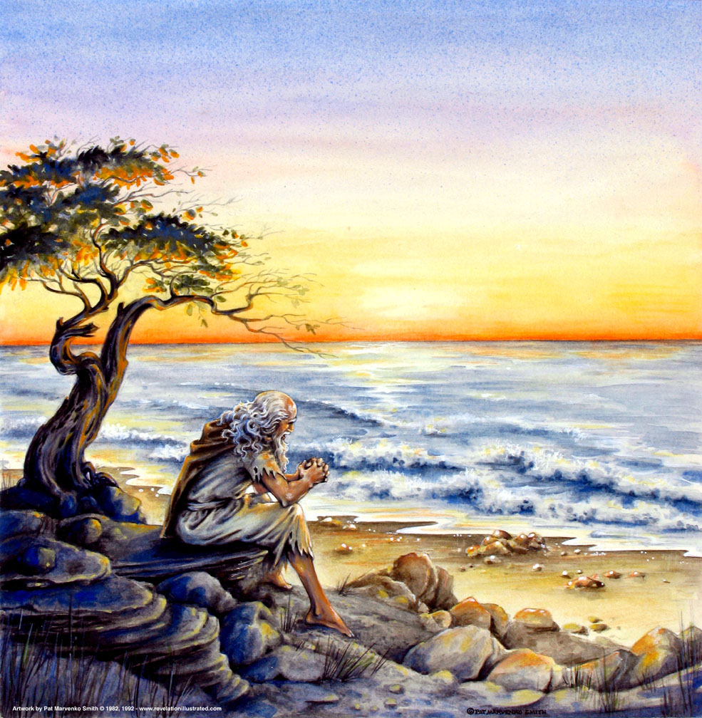
"…on the Lord's day…" (1:10)
319
Sunday?
The "Day of the LORD"?

Slide 40
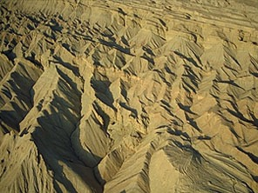
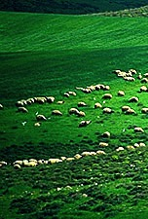
The Day of the LORD
OT Survey 638-639
Judgment
+
Blessing
Tribulation
Millennium
Rev. 6–19
Rev. 20
7 years
1000 years

Slide 41
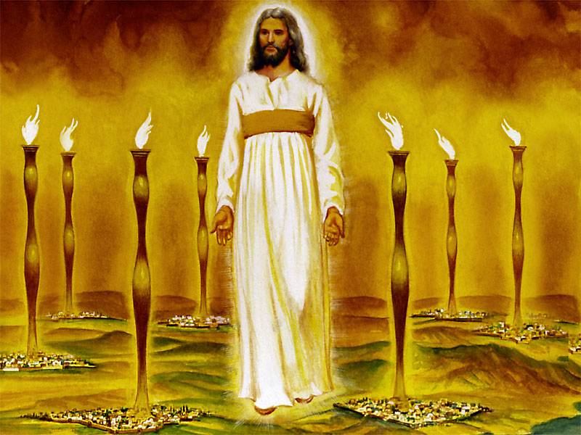
John's vision of the glorified Christ proves He can handle the Church's internal and external problems (1:12-16)
343
Notes:
"Christ's garments are those of a Judge-King, One with honor and authority. The white hair symbolizes His eternality, "the Ancient of Days" (Dan. 7:9, 13, 22). His eyes see all (Rev. 19:12; Heb. 4:12), enabling Him to judge righteously. His feet of burning brass also suggest judgment, since the brazen altar was the place where the fire consumed the sin offering. The Lord had come to judge the churches, and He would also judge the evil world system.
The "sound of many waters" (Rev. 1:15) makes me think of Niagara Falls! Perhaps two ideas are suggested here: (1) Christ gathers together all the "streams of revelation" and is the Father's "last Word" to man (Heb. 1:1–3); (2) He speaks with power and authority and must be heard. The sword from His mouth certainly represents the living Word of God (Heb. 4:12; Eph. 6:17). He fights His enemies by using His Word (Rev. 2:16; 19:19–21)" (Wiersbe).

Slide 42
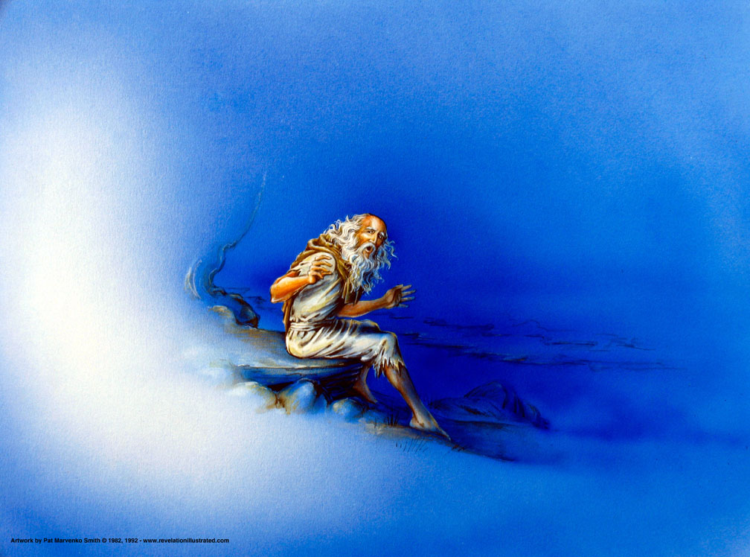
"It was the Lord's Day, and I was worshiping in the Spirit. Suddenly, I heard behind me a loud voice like a trumpet blast" (1:10 NLT).

Slide 43
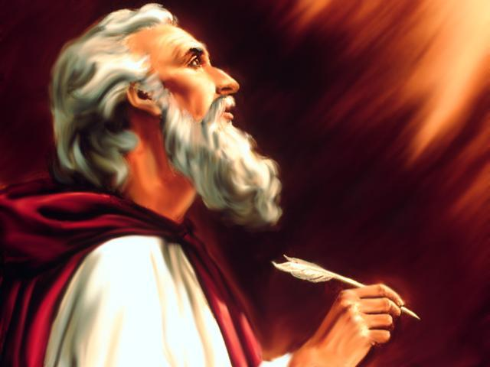
"I saw…" (1:12)
1:12
1:17
4:1
5:1
5:2
5:6
5:11
6:1
6:2
6:5
6:8
6:9
6:12
7:1
7:2
7:9
8:2
8:13
9:1
9:17
10:1
10:5
13:1
13:2
13:11
14:1
14:6
14:14
15:1
15:2
15:5
16:13
17:3
17:6
18:1
19:11
19:17
19:19
20:1
20:4
20:11
20:12
21:1
21:2
21:22
p. 322 Point B
This exact verb form is used 45 times in Revelation!
ei=don

Slide 44
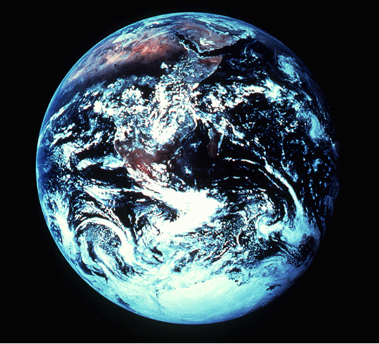
NOW…TO COMPLETE THE PORTRAIT…
343
Revelation 1:12-18 (NIV) ¹²I turned around to see the voice that was speaking to me. And when I turned I saw seven golden lamp stands,
MATTHEW
MARK
THE REVELATION OF JESUS CHRIST TO JOHN THE APOSTLE
¹³and among the lamp stands was someone "like a son of man," dressed in a robe reaching down to his feet and with a golden sash around his chest.
¹⁴His head and hair were white like wool, as white as snow, and his eyes were like blazing fire.
¹⁵His feet were like bronze glowing in a furnace, and his voice was like the sound of rushing waters.
¹ ¹⁶In his right hand he held seven stars, and out of his mouth came a sharp double-edged sword. His face was like the sun shining in all its brilliance.
LUKE
JOHN
¹⁷When I saw him, I fell at his feet as though dead. Then he placed his right hand on me and said: "Do not be afraid. I am the First and the Last.
¹⁸I am the Living One; I was dead, and behold I am alive for ever and ever! And I hold the keys of death and Hades."
28
9
Notes:
Now…to complete the portraits given to us by
MATTHEW…MARK…LUKE…and JOHN.
//// For this, we need to get out into space and look at this unfortunate planet. Man has made a mess of it, you will probably agree. This view of earth helps us more clearly understand the final view of Christ given to us in the New Testament.
//// Now travel to the last book of the New Testament…The Revelation of Jesus Christ to John the Apostle. There, we see Jesus Christ in His risen, ascended glory, as he will appear when He returns at the end of History to reclaim all that is His.
//// In his first chapter of The Revelation, John writes this:
I turned around to see the voice that was speaking to me. And when I turned I saw seven golden lamp stands…
//// and among the lamp stands was someone "like a son of man," dressed in a robe reaching down to his feet and with a golden sash around his chest.
//// His head and hair were white like wool, as white as snow, and his eyes were like blazing fire.
//// His feet were like bronze glowing in a furnace, and his voice was like the sound of rushing waters.
//// In his right hand he held seven starts, and out of his mouth came a sharp double-edged sword. His face was like the sun shining in all its brilliance.
//// When I saw him, I fell at his feet as though dead. Then he placed his right hand on me and said: "Do not be afraid. I am the First and the Last.
//// I am the Living one; I was dead, and behold I am alive forever and ever! And I hold the keys the death and Hades.

Slide 45
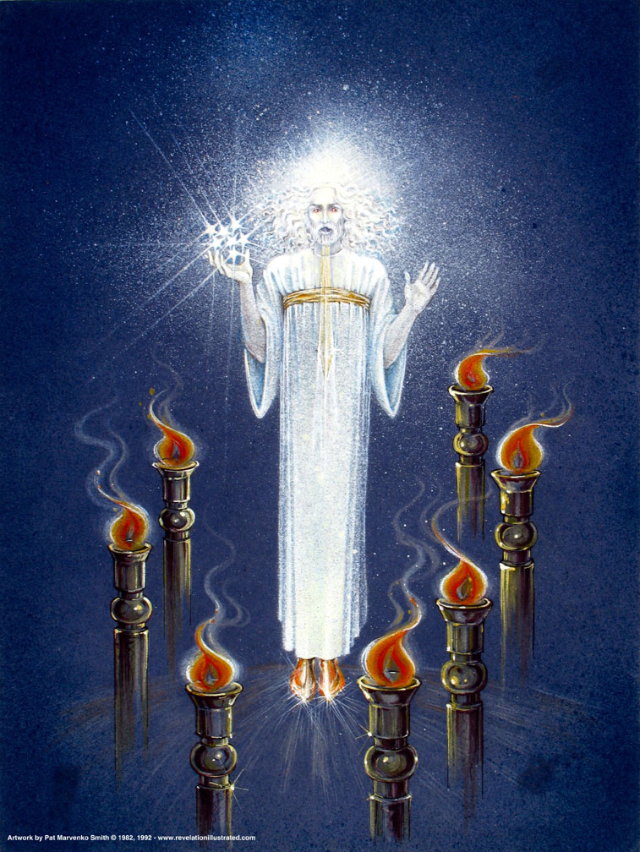
Christ Among the Lamp Stands (1:12-16)
Notes:
"Christ's garments are those of a Judge-King, One with honor and authority. The white hair symbolizes His eternality, "the Ancient of Days" (Dan. 7:9, 13, 22). His eyes see all (Rev. 19:12; Heb. 4:12), enabling Him to judge righteously. His feet of burning brass also suggest judgment, since the brazen altar was the place where the fire consumed the sin offering. The Lord had come to judge the churches, and He would also judge the evil world system" (Wiersbe).

Slide 46
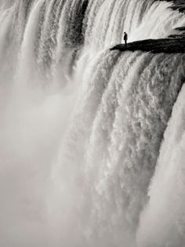
"…voice of many waters" (1:15)
Notes:
"The "sound of many waters" (Rev. 1:15) makes me think of Niagara Falls! Perhaps two ideas are suggested here: (1) Christ gathers together all the "streams of revelation" and is the Father's "last Word" to man (Heb. 1:1–3); (2) He speaks with power and authority and must be heard." (Wiersbe).

Slide 47
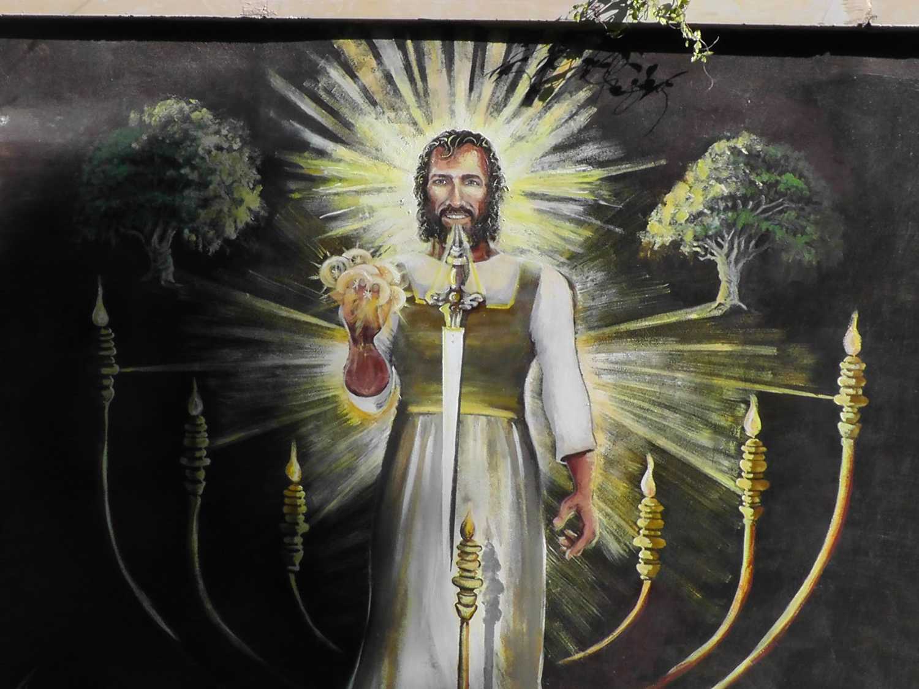
"…sword from his mouth" (1:16)
Notes:
"The sword from His mouth certainly represents the living Word of God (Heb. 4:12; Eph. 6:17). He fights His enemies by using His Word (Rev. 2:16; 19:19–21)" (Wiersbe).

Slide 48
OT Parallels to Jesus in Rev. 1:12-16
343
Rev. 1:12-16 | Ezek. 1:24-28 | Dan. 10:5-6 | Dan. 7:9-10 | Dan. 7:13-14
son of man | like that of a man | a man |  | son of man
robe |  | linen robe
gold sash |  | gold sash
white hair |  |  | white hair
eyes like fire | fire | eyes like flame | fire
feet like bronze | glowing metal | gleaming bronze
voice like rushing water | sound like rushing water | sound of a multitude
stars in hand
face like the sun | radiance | like lightning
Adapted from Vern Poythress at www.frame-poythress.org

Slide 49
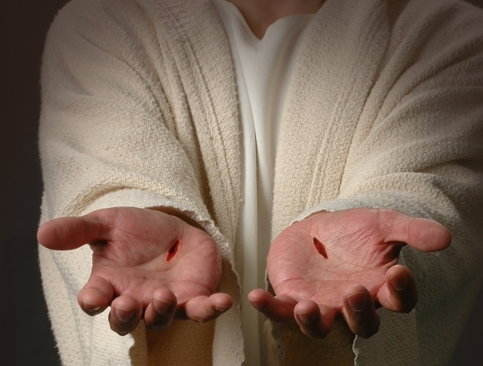
"When I saw him, I fell at his feet as if I were dead. But he laid his right hand on me and said, "Don't be afraid! I am the First and the Last. ¹⁸I am the living one. I died, but look—I am alive forever and ever! And I hold the keys of death and the grave" (1:17-18 NLT)
343

Slide 50
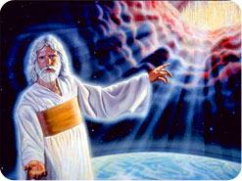
338
Follow Revelation's inspired outline
Revelation 1:19 "Therefore write the things which you have seen, and the things which are, and the things which will take place after these things" (NAU).
have seen
are
will take place

Slide 51
Revelation
Sovereignty of Christ in Future Victory
Sovereignty in His Person |  |  | Sovereignty over Churches | Sovereignty in End-Time Events
Chapter 1 |  |  | Chapters 2–3 | Chapters 4–22
"What you have seen" (1:19a) |  |  | "What is now" (1:19b) | "What will take place later" (1:19c)
Past |  |  | Present | Future
Christ Unveiled |  |  | Churches Unveiled | Consummation Unveiled
God on Earth |  |  | God's Ambassadors on Earth | Hell on Earth to Heaven on Earth
The Judge |  |  | The Assignments | The Judgments & Rewards
Subject 1:1-3 | Worship of Trinity 1:4-8 | Glorified Christ 1:9-20 | Seven Churches of Asia: Ephesus Smyrna Pergamum Thyatira Sardis Philadelphia Laodicea | Tribulation 4:1–19:10 | Second Coming 19:11-21 | Millennium 20 | Eternal State 21:1–22:5 | Closing: Imminency 22:6-21
AD 95
318, 324 M

Slide 52
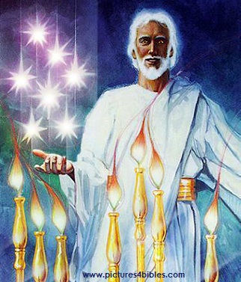
What are the 7 Stars & 7 Lampstands (1:20 NLT)?
"This is the meaning of the mystery of the seven stars you saw in my right hand and the seven gold lampstands: The seven stars are the angels of the seven churches, and the seven lampstands are the seven churches."

Slide 53
Revealing the sovereignty of Jesus Christ helped convince the seven churches in Asia that Christ could conquer their internal compromise and external opposition
Title Page 321
Asian Churches
Rome
2. External Persecution from Rome (1:9; 2:9-10; 3:10)
1. Internal Struggles inside churches (2:4, 14-15, 21-24; 3:1, 15-17)

Slide 54
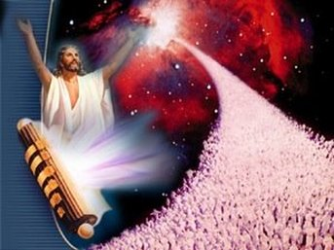
Jesus rules the world! So he can handle your puny problem.
The Big Idea

Slide 55
Why should we know that Jesus rules the world?
318
Why read Revelation?
So you'll be blessed!
Why worship Jesus?
He's coming back!
Why see Jesus clearly?
He can solve your problems!

Slide 56
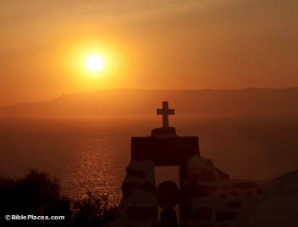
What's your view of Jesus?

Slide 57
Summing Up the Whole Book
343
God discloses through John the sovereignty of Jesus Christ in His ultimate future triumph to encourage believers to persevere despite internal compromise and external opposition

Slide 58
Jesus Wins!
Series on Revelation

Slide 59
Black

Slide 60
Christology link at BibleStudyDownloads.org
Get this presentation for free!
Notes:
Creation (cr)

